Slide 1


Slide 2

Deep learning-based Sentiment Analysis in the Natural Language Processing Methodology

Slide 3
INTRODUCTION
The main objective of our project is to create an advanced and robust Sentiment Analysis model using Deep Learning methods to gain insights from textual data.
Our project leverages the power of two diverse datasets, each offering unique insights and presenting distinct challenges. This approach ensures a comprehensive analysis that accommodates various linguistic styles and contexts.
We employ three different types of embeddings to enrich our analysis. These embeddings add depth and nuance to the model, allowing it to understand and interpret textual data with a higher level of sophistication.
We have developed two hybrid models.
CNN-LSTM model
CNN-LSTM-Transformer model

Slide 4
DATASETS
For our project, we are utilizing two distinct types of datasets. One of the datasets is Twitter US Airline dataset, which consists of 1 - 2 lines of tweets, and the other is IMDB Movie Review dataset, which consists of paragraph reviews.
Assessing the model's effectiveness in several scenarios, such as the Twitter US Airline dataset and the IMDB Movie Review dataset to determine its flexibility and capacity to generalize sentiment analysis across multiple textual sources.

Slide 5
TWITTER US AIRLINE DATASET
It is collected from Kaggle and includes sentimental tweets made by travelers in February 2015 on Twitter. It consists of tweets related to six major U.S. airlines: Delta, Virgin America, Southwest, United, American, and US Airways.
This dataset has 14640 rows and 15 attributes. They are as follows:
tweet_id
airline_sentiment
airline_sentiment_confidence
negativereason
negativereason_confidence
airline
airline_sentiment_gold
name
negativereason_gold
retweet_count
text
tweet_coord
tweet_created
tweet_location
user_timezone

Slide 6
IMDB DATASET
It is collected from Stanford University.
It is a dataset of 50k movie reviews for binary sentiment classification.
This dataset comprises tweets that are in a paragraph format.

Slide 7
EXPLORATORY DATA ANALYSIS

Slide 8
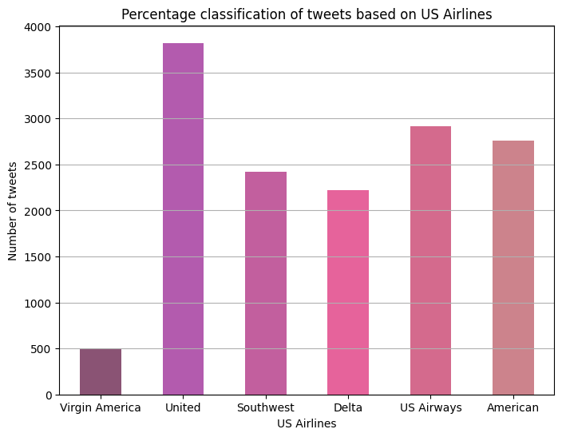
EDA – TWITTER US AIRLINE DATASET
Fig 1.1: Percentage classification of tweets based on US Airlines

Slide 9
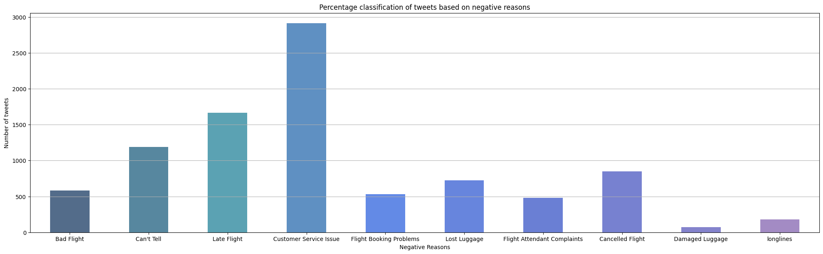
EDA – TWITTER US AIRLINE DATASET
Fig 1.2: Percentage classification of tweets based on negative reasons

Slide 10
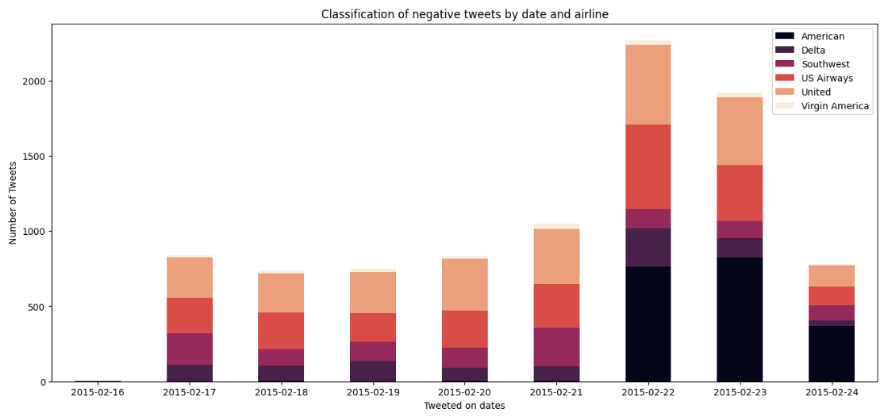
EDA – TWITTER US AIRLINE DATASET
Fig 1.3: Classification of negative tweets by date and airline

Slide 11
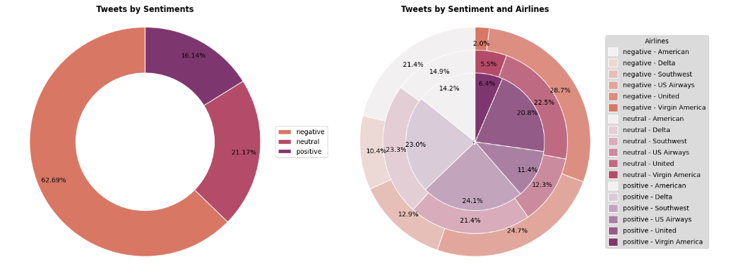
EDA – TWITTER US AIRLINE DATASET
Fig 1.4: Tweets by sentiment

Slide 12
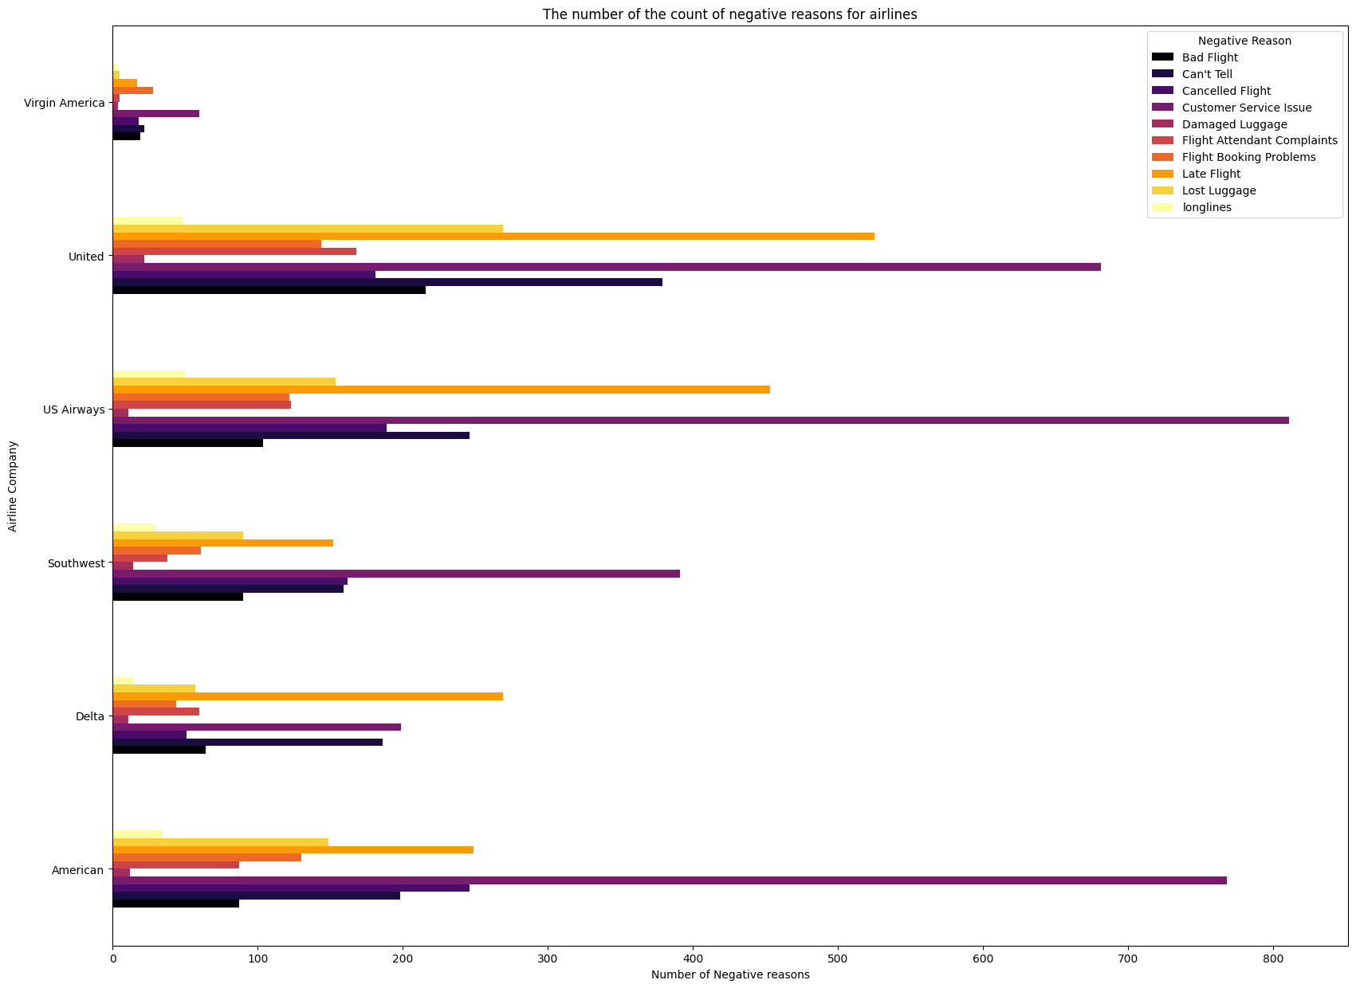
EDA – TWITTER US AIRLINE DATASET
Fig 1.5: Tweets by sentiment

Slide 13
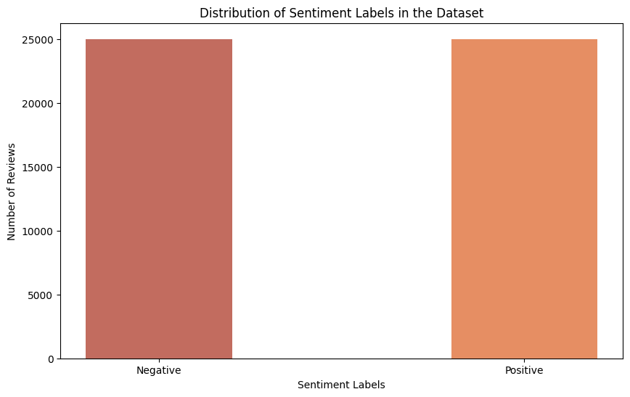
EDA – IMDB MOVIE REVIEWS DATASET
Fig 2.1 Distribution of sentiment analysis in the dataset

Slide 14
DATA PREPROCESSING
The initial stage of data preparation, known as Data Preprocessing, involves cleaning, transforming, and organizing raw data to make it appropriate for analysis.
The foundation of sound data analysis is Data Preprocessing. It has a direct impact on the quality and reliability of the outcomes.

Slide 15
DATA CLEANING
Modified the data type for enhanced memory optimization and improved data handling flexibility
Unwanted attributes were removed.
Missing data management
Taking care of undesirable outliers
Data Cleaning

Slide 16
DATA PREPROCESSING
Data Preprocessing
Lemmatization
Removing Stopwords
Converting emoji's
Removing numbers
Removing punctuations
Removing extra space
Removing contractions
Tokenization
Lowercasing the data

Slide 17
TWITTER US AIRLINE DATASET

Slide 18
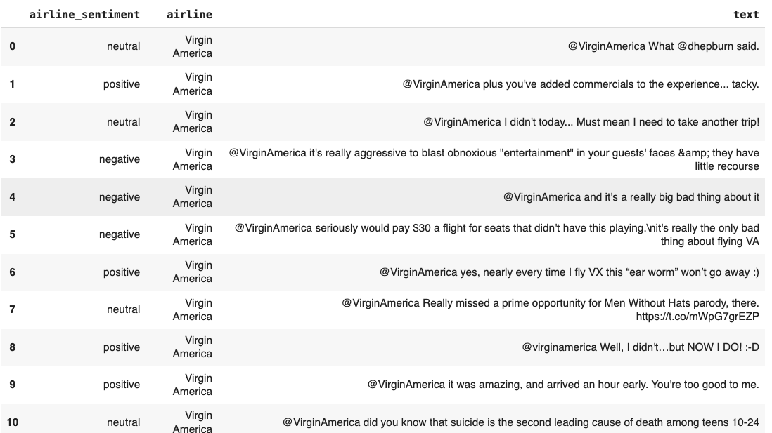
DATA PREPROCESSING
Before Data Preprocessing

Slide 19
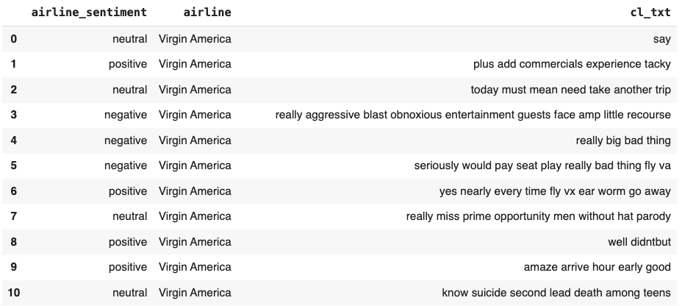
DATA PREPROCESSING
After Data Preprocessing

Slide 20
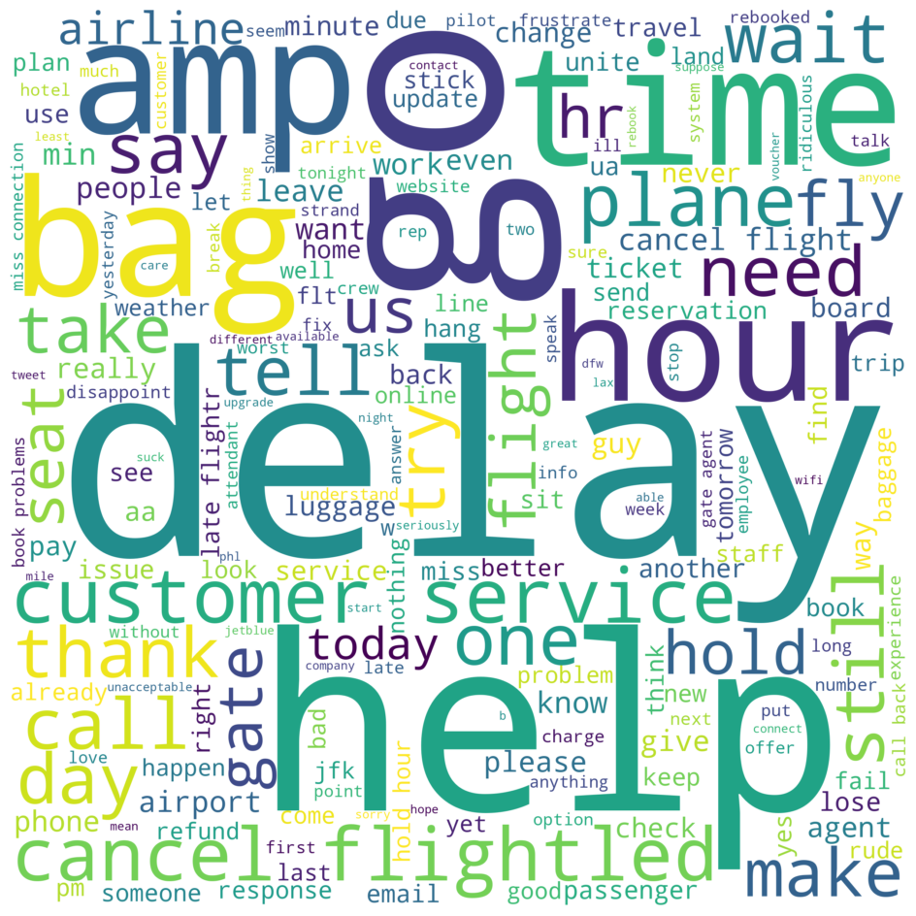


WORDCLOUD
NEGATIVE WORDCLOUD
POSITIVE WORDCLOUD
NEUTRAL WORDCLOUD

Slide 21
IMDB DATASET

Slide 22
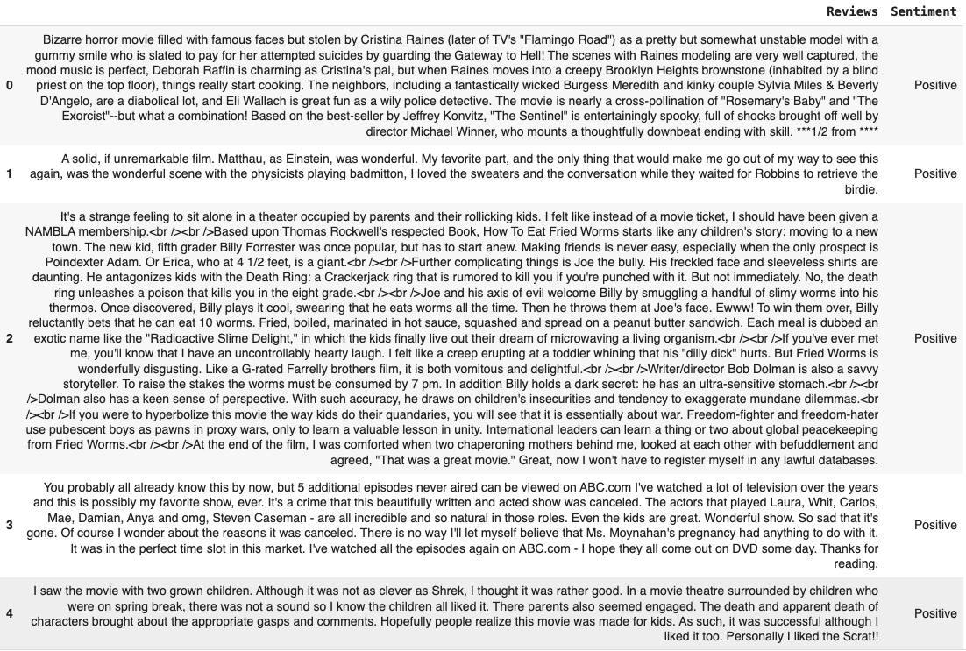
DATA PREPROCESSING
Before Data Preprocessing

Slide 23
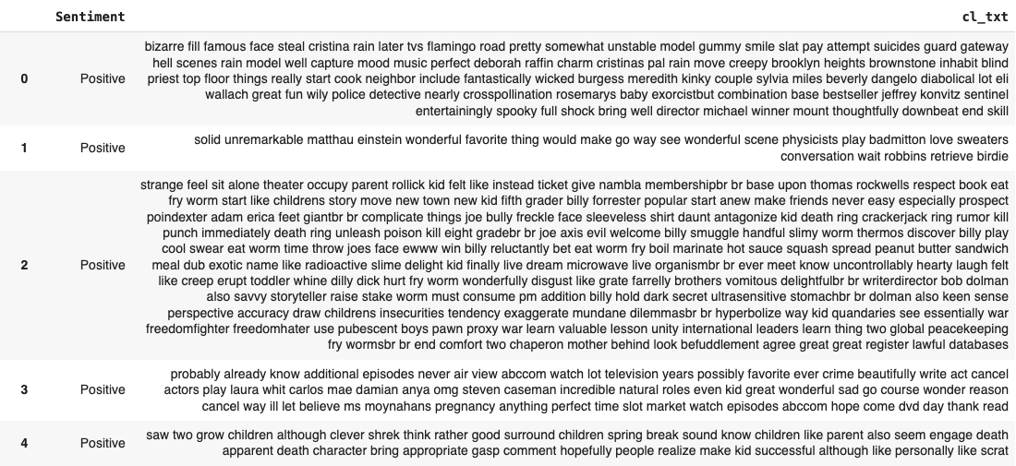
DATA PREPROCESSING
After Data Preprocessing

Slide 24
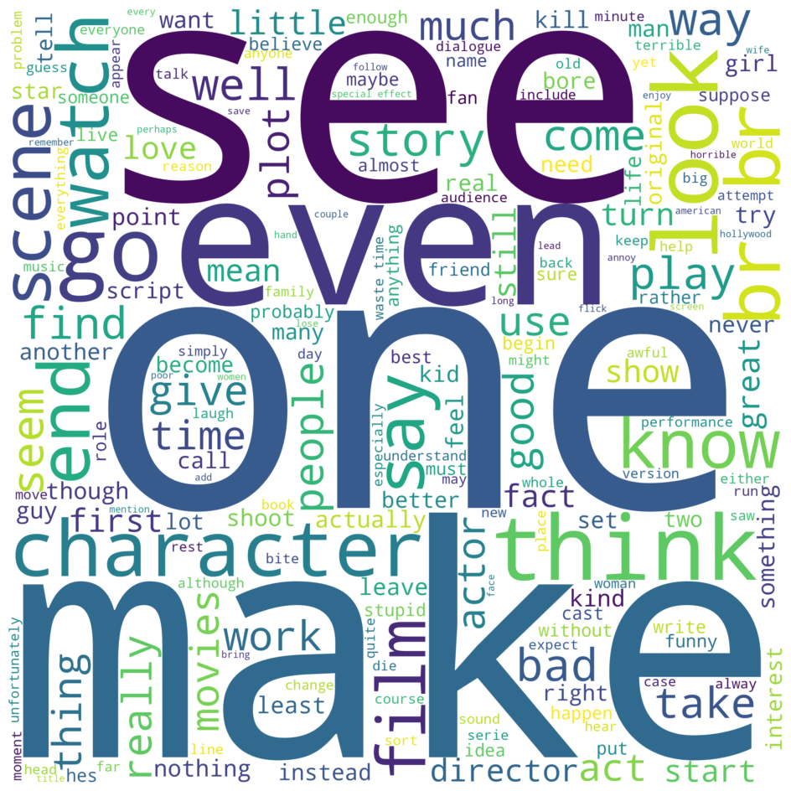

WORDCLOUD
NEGATIVE WORDCLOUD
POSITIVE WORDCLOUD

Slide 25



WORD EMBEDDINGS
Word2Vec
fastText
Keras Embedding

Slide 26
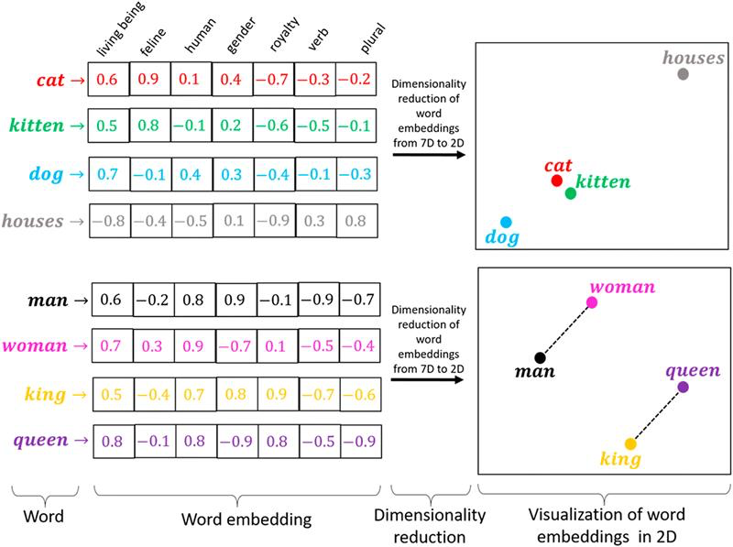
Word2Vec
Word2Vec (Word to Vector) is a prominent word embedding technique in natural language processing (NLP) that expresses words as dense vectors in a continuous vector space.
Benefits of Using Word2Vec:
Understanding Semantics
Reduced Dimensionality
Generalization
Contextual Information

Slide 27
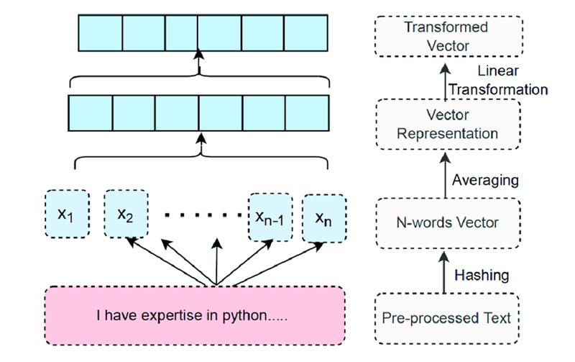
fastText
fastText is an open-source, free, and lightweight software that enables users to learn text representations and text classifiers.
Common Crawl fastText refers to the usage of the fastText natural language processing toolkit to analyze and process text data taken from the Common Crawl web dataset, enabling a wide range of text-based applications such as web content classification and analysis.
On Common Crawl, 2 Million word vectors were learned using sub-word information (600B tokens).

Slide 28
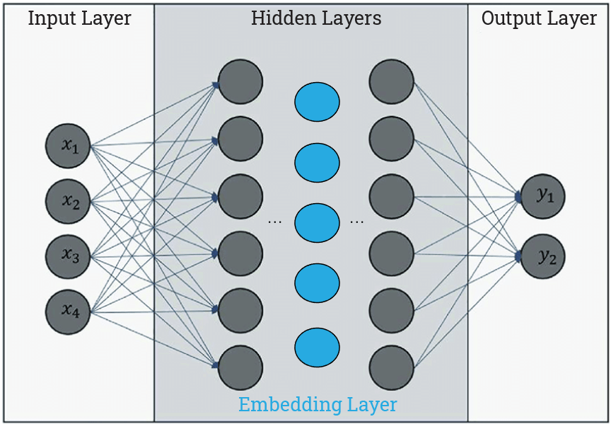
Keras Embedding Layer
Keras provides an Embedding layer for neural networks using text data. It requires integer encoding of the input data, so that each word is represented by a unique integer.
It is a versatile layer that may be utilized in a variety of ways, including:
Learning a word embedding that can be saved and reused in another model later.
Can be utilized in a deep learning model, where the embedding is taught alongside the model.
Capable of loading a pre-trained word embedding model, which is a sort of transfer learning.

Slide 29

Why three types of Embeddings?

Slide 30
Why three types of Embeddings?
fastText extends Word2Vec by considering sub-word information, allowing it to represent words as a combination of their sub-word components (character n-grams). This means fastText can handle out-of-vocabulary words and capture the meaning of morphemes and affixes.
Keras Embeddings are integrated into the Keras deep learning framework. fastText and Word2Vec, on the other hand, are standalone techniques for generating word embeddings.

Slide 31
Regularization & Optimization Techniques

Slide 32
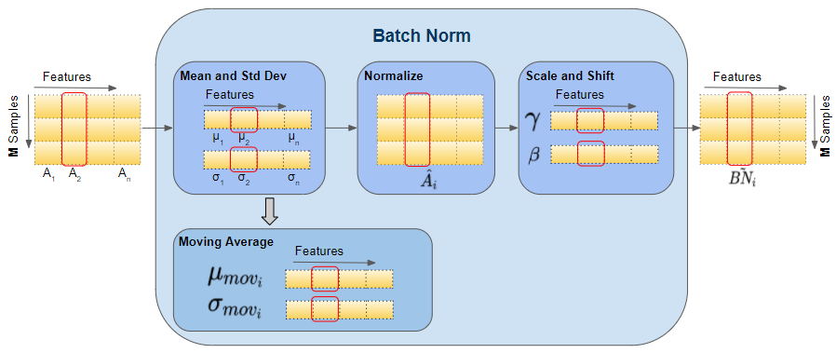
BATCH NORMALIZATION
Batch normalization helps in mitigating the internal covariate shift problem, which is the change in the distribution of the inputs to a neural network layer during training. It normalizes the input of each layer in a mini-batch, making the optimization process more stable and reducing the risk of overfitting.

Slide 33
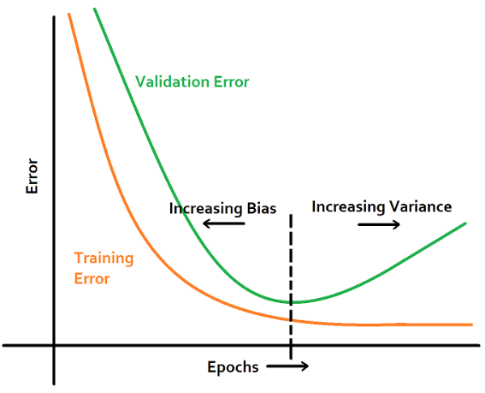
EARLY STOPPING
Early stopping is a regularization technique that helps prevent overfitting by stopping the training process once the performance on a validation set starts to degrade. It prevents the model from continuing to learn noise in the training data.

Slide 34
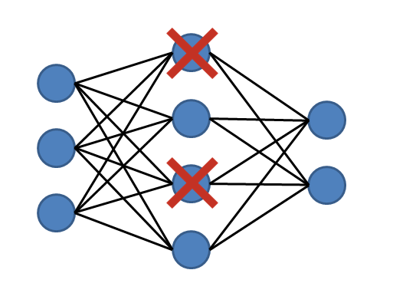
DROPOUT LAYER
Dropout is a regularization technique where randomly selected neurons are ignored during training. This prevents the network from relying too much on specific neurons and helps to improve generalization.

Slide 35
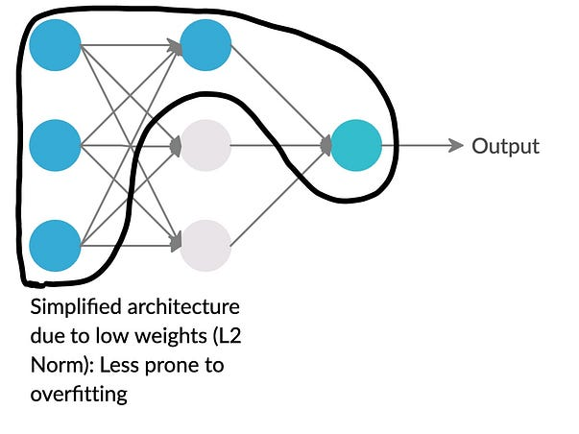
L2 REGULARIZATION
L2 regularization adds a penalty term to the loss function based on the squared magnitudes of the weights. This penalizes large weights and discourages the model from fitting the training data too closely, helping to prevent overfitting.

Slide 36
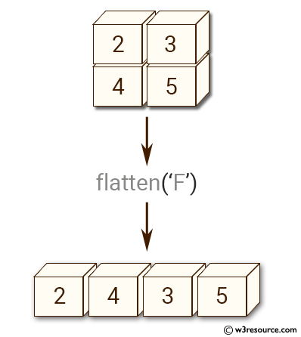
FLATTENING LAYER
Flattening is a process in neural networks where the multi-dimensional data (e.g., the output of convolutional layers) is converted into a one-dimensional array. It is often used before feeding the data into fully connected layers.

Slide 37
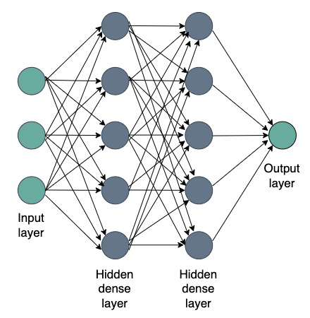
DENSE LAYERS
Employing dense layers alongside dropout or weight regularization techniques and fine-tuning the network's complexity by adjusting the number of layers and neurons can help prevent overfitting in neural networks.

Slide 38
ENHANCEMENTS IN OUR MODEL
Emojis as Contextual Cues: Unlike the reference publications, we acknowledge that the way sentiment is conveyed in textual data is significantly influenced by emojis. These symbols provide our machine a better understanding of the context, which improves the accuracy and sentiment analysis. Emojis have become an important aspect of modern communication, particularly in textual data like social media postings, chats, and online reviews. They act as vital contextual signals, conveying emotions, tone, and mood in ways that mere text cannot do. Understanding the subtleties communicated by emojis is critical for machine and algorithm sentiment analysis.
Comparative Analysis: We evaluated how effectively emojis are incorporated for improved contextual comprehension and how each approach affects sentiment classification accuracy by correlating fastText, Keras Embedding Layer, and Word2Vec in our CNN-LSTM and CNN-LSTM-Transformer sentiment analysis models.

Slide 39
CNN-LSTM
HYBRID MODEL

Slide 40
In this project we are using CNN-LSTM Hybrid model.
CNN Model in Sentiment Analysis:
Local Feature Learning
Robustness to Noise
LSTM Model in Sentiment Analysis:
Processing Sequential Information
Managing Variable-Length Sequences
CONVOLUTION NEURAL NETWORK - LONG SHORT-TERM MEMORY (CNN-LSTM)
HYBRID MODEL

Slide 41
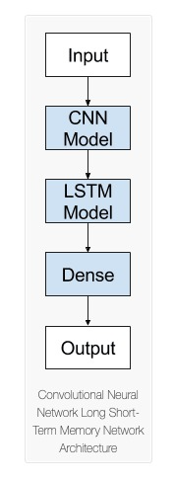
ARCHITECTURE OF OUR PROPOSED CNN-LSTM HYBRID MODEL

Slide 42
REASONS FOR IMPLEMENTING CNN-LSTM HYBRID MODEL
Strengths When Used Together: Using the benefits of both CNNs and LSTMs, the hybrid model can simultaneously capture dependence over time and local attributes.
Better Feature Extraction: Local characteristics may be effectively extracted by the CNN component and then fed into the LSTM to capture the context and sequential information, resulting in a more comprehensive understanding of the text.
Reduced Overfitting: By combining the power of the LSTM to generalize patterns across sequences and the CNN's feature extraction capabilities, the combination of the two models lessens overfitting.
Complex Context Understanding: When it comes to understanding both local and global context, our hybrid approach performs better, which may produce better results for sentiment analysis in text data.

Slide 43
TWITTER US AIRLINE DATASET

Slide 44
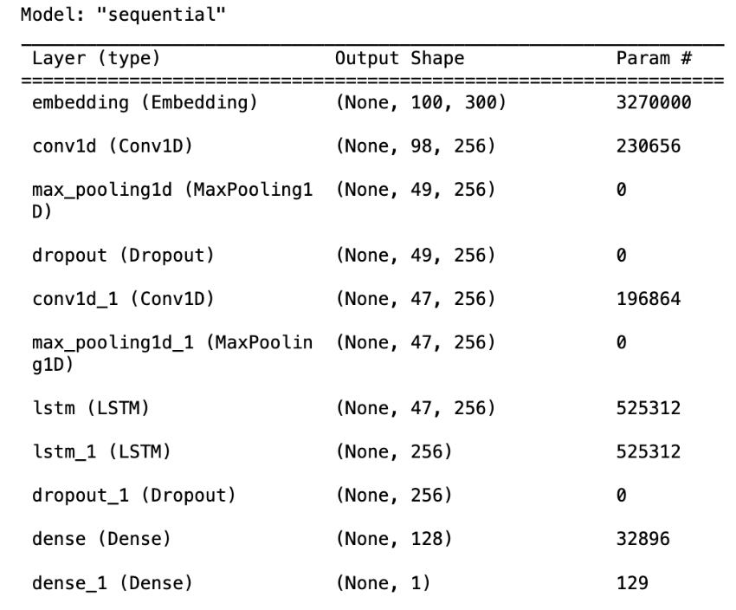
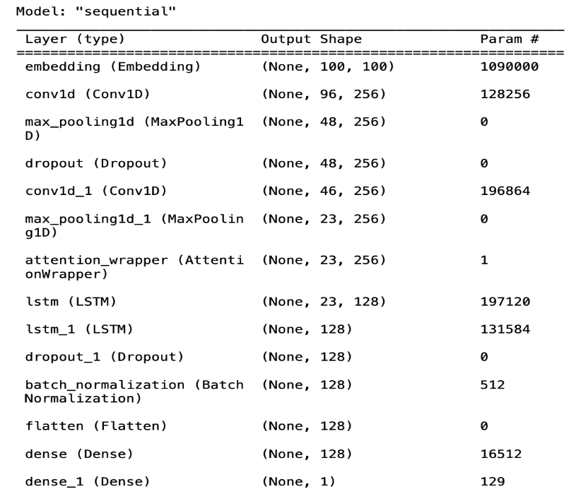
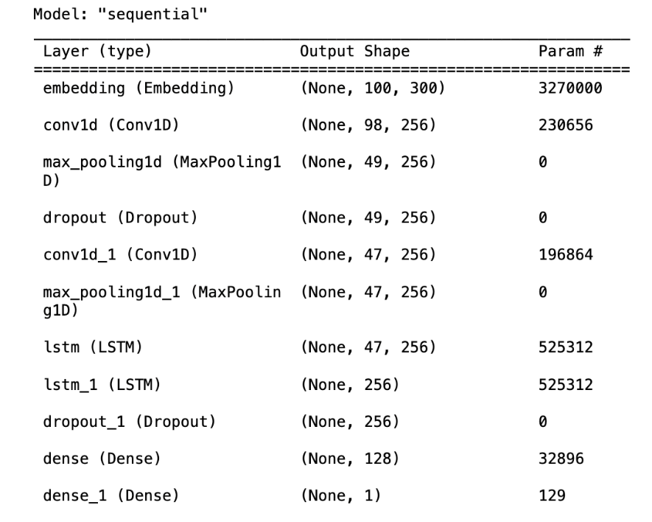
SUMMARY OF MODELS
fastText
Keras Embedding Layer
Word2Vec
The summary shows that we have used three different embeddings.
In each embedding we used different layers to get the highest accuracy possible.

Slide 45

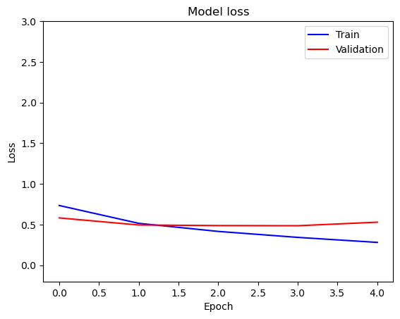
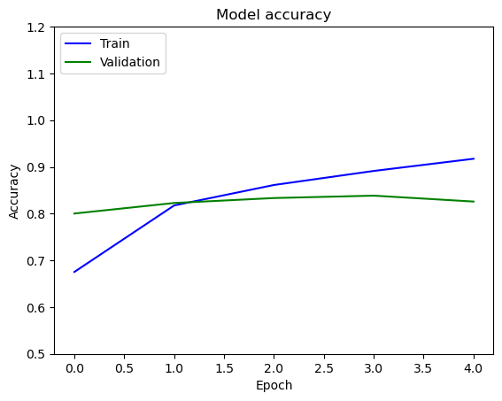
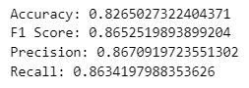
RESULTS – TWITTER DATASET FASTTEXT EMBEDDING

Slide 46
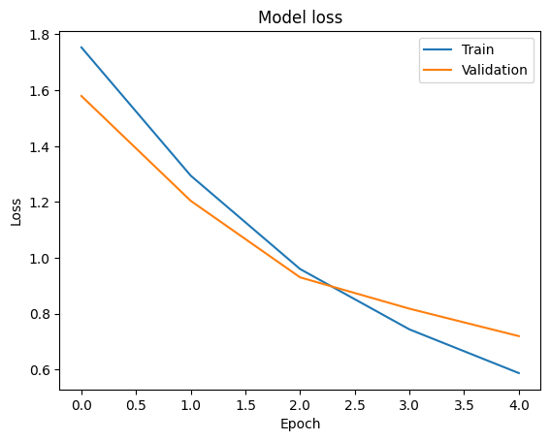
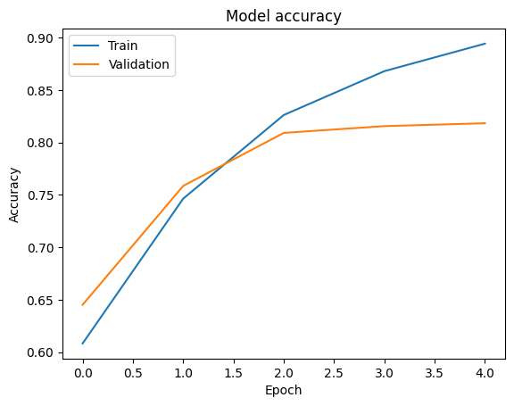
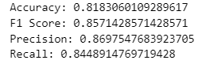
RESULTS – TWITTER DATASET KERAS EMBEDDING

Slide 47
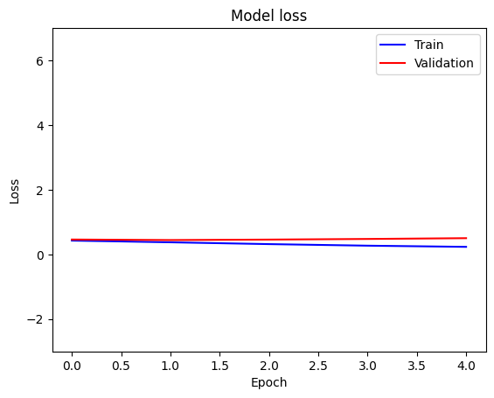
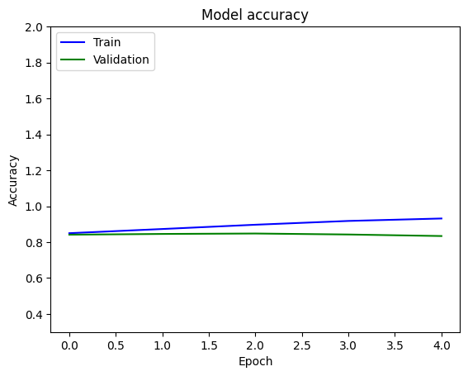
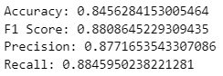
RESULTS – TWITTER DATASET WORD2VEC EMBEDDING

Slide 48
For Twitter US Airline Dataset, implementing CNN-LSTM Model with Word2Vec embedding gave us highest accuracy of 84.56%.

Slide 49
IMDB MOVIE REVIEW DATASET

Slide 50
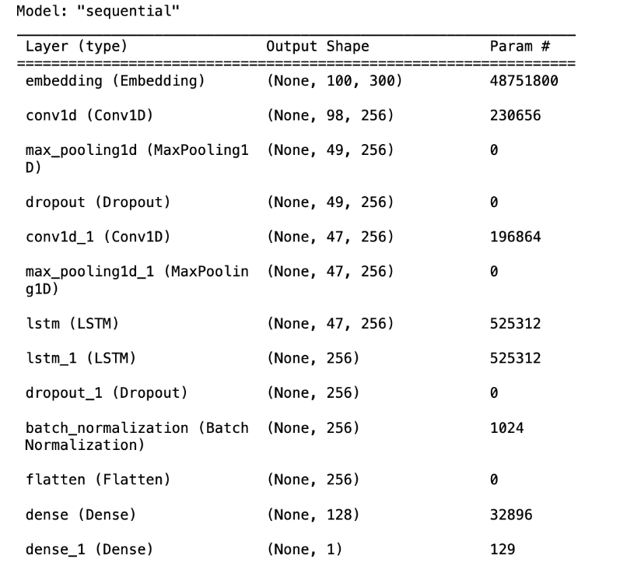
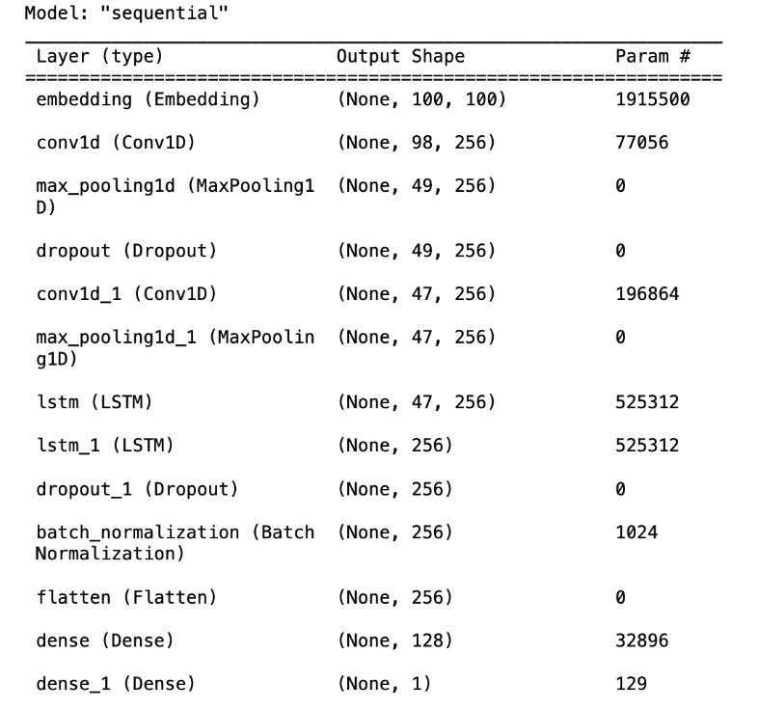
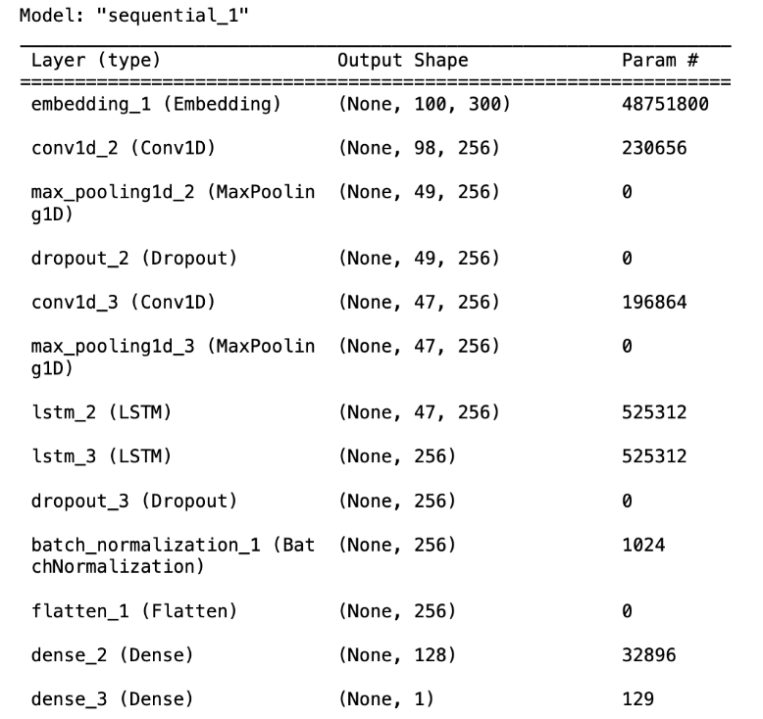
SUMMARY OF MODELS
fastText
Keras Embedding Layer
Word2Vec
The summary shows that we have used three different embeddings.
In each embedding we used different layers to get the highest accuracy possible.

Slide 51
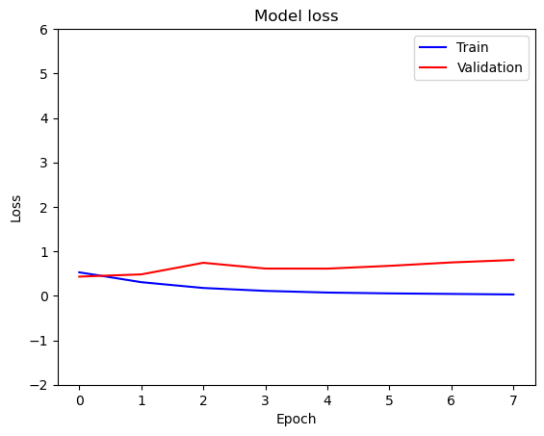
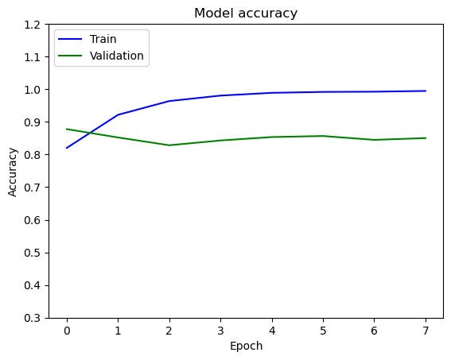
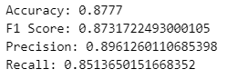
RESULTS – IMDB DATASET FASTTEXT EMBEDDING

Slide 52
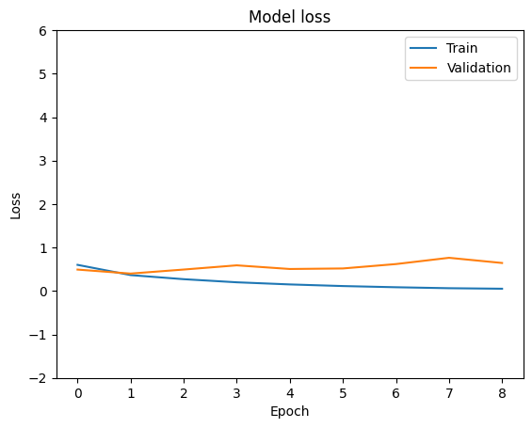
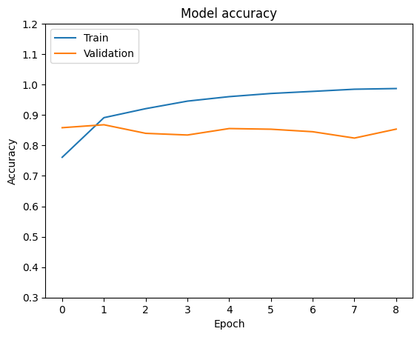
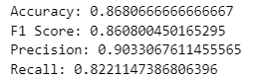
RESULTS – IMDB DATASET KERAS EMBEDDING

Slide 53
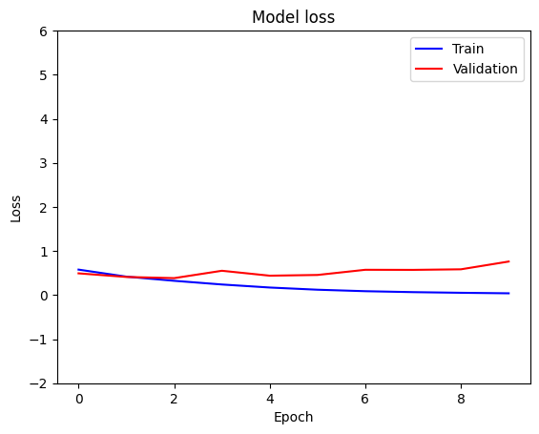
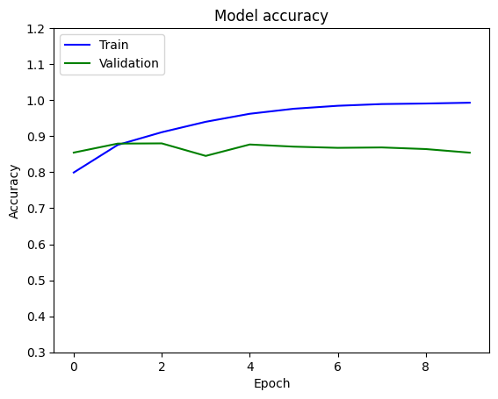
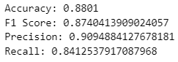
RESULTS – IMDB DATASET WORD2VEC EMBEDDING

Slide 54
For IMDB Movie Review Dataset, implementing CNN-LSTM Model with Word2Vec embedding gave us highest accuracy of 88.01%.

Slide 55
CNN-LSTM-TRANSFORMER
HYBRID MODEL

Slide 56
CONVOLUTION NEURAL NETWORK - LONG SHORT-TERM MEMORY - TRANSFORMER (CNN-LSTM-TRANSFORMER)
HYBRID MODEL
In this project we are using CNN-LSTM-Transformer Hybrid model.
CNN Model in Sentiment Analysis:
Local Feature Learning
Robustness to Noise
LSTM Model in Sentiment Analysis:
Processing Sequential Information
Managing Variable-Length Sequences
Transformer in Sentiment Analysis:
Global contextual insight
Improving the model's capacity to capture both short and long-range dependencies in sentiment data.

Slide 57
ARCHITECTURE OF OUR PROPOSED CNN-LSTM-TRANSFORMER HYBRID MODEL

Slide 58
REASONS FOR IMPLEMENTING CNN-LSTM-TRANSFORMER HYBRID MODEL
Hierarchical Information Processing: Captures local and global features simultaneously, providing a hierarchical understanding of sentiment-related patterns.
Temporal Dependency Management: Handles variable-length sequences, capturing temporal dependencies and contextual nuances in sentiment expression.
Global Contextual Integration: Incorporates attention mechanisms for comprehensive analysis, considering both short and long-range dependencies for nuanced sentiment comprehension.
Synergistic Fusion for Enhanced Performance: Integrates CNN, LSTM, and Transformer, leveraging their complementary strengths to create a holistic sentiment analysis model with improved adaptability and performance.

Slide 59
TWITTER US AIRLINE DATASET

Slide 60
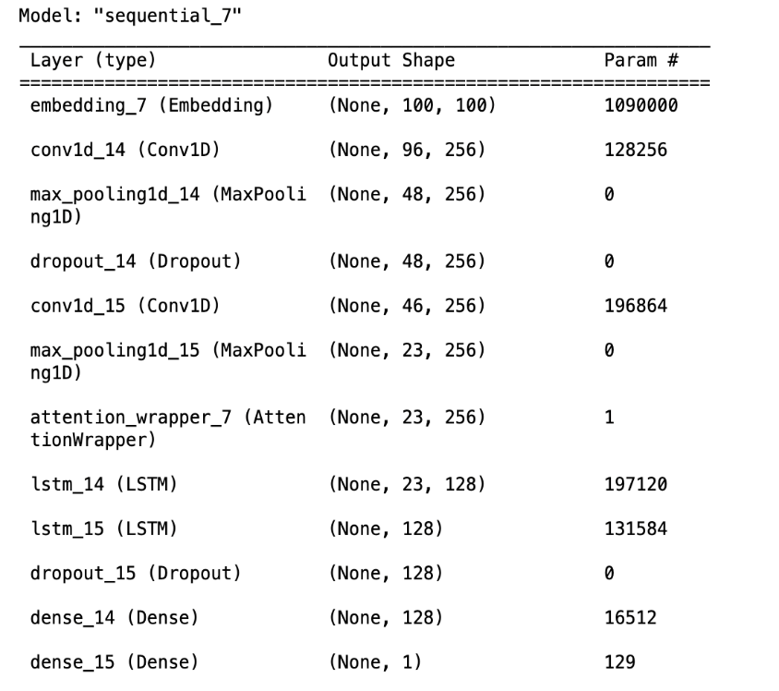
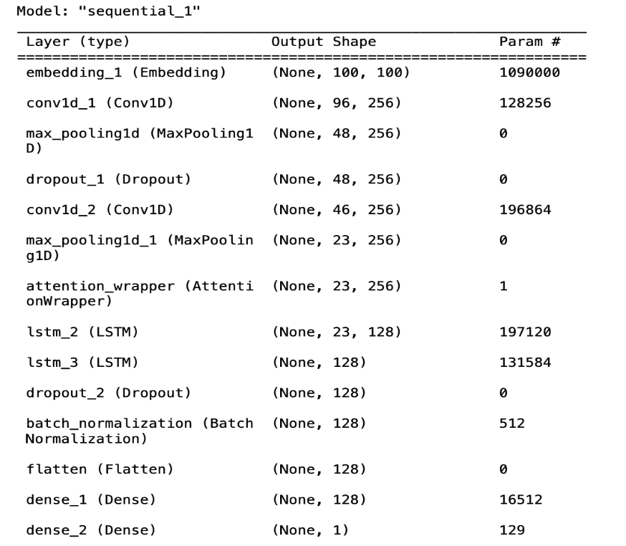
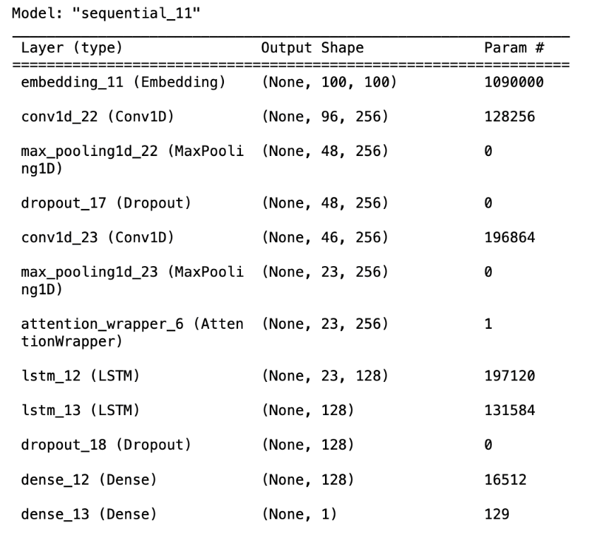
SUMMARY OF MODELS
fastText
Keras Embedding Layer
Word2Vec
The summary shows that we have used three different embeddings.
In each embedding we used different layers to get the highest accuracy possible.

Slide 61
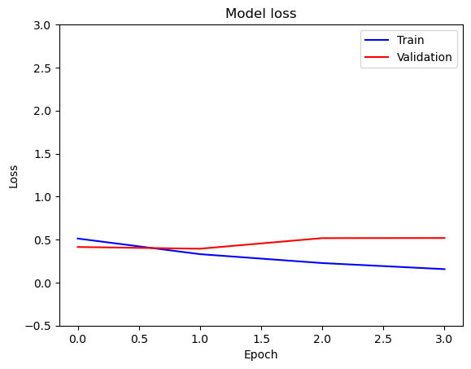


RESULTS – TWITTER DATASET FASTTEXT EMBEDDING

Slide 62



RESULTS – TWITTER DATASET KERAS EMBEDDING

Slide 63



RESULTS – TWITTER DATASET WORD2VEC EMBEDDING

Slide 64
For Twitter US Airline Dataset, implementing CNN-LSTM-Transformer Model with fastText embedding gave us highest accuracy of 83.7%.

Slide 65
IMDB MOVIE REVIEW DATASET

Slide 66



SUMMARY OF MODELS
fastText
Keras Embedding Layer
Word2Vec
The summary shows that we have used three different embeddings.
In each embedding we used different layers to get the highest accuracy possible.

Slide 67



RESULTS – IMDB DATASET FASTTEXT EMBEDDING

Slide 68



RESULTS – IMDB DATASET KERAS EMBEDDING

Slide 69



RESULTS – IMDB DATASET WORD2VEC EMBEDDING

Slide 70
For IMDB Movie Review Dataset, implementing CNN-LSTM-Transformer Model with fastText embedding gave us highest accuracy of 87.02%.

Slide 71
SUMMARY

Slide 72
MODELS IMPLEMENTED | ACCURACIES OF THE MODEL
Twitter US Airline Dataset CNN LSTM Keras Embedding | 81.83%
Twitter US Airline Dataset CNN LSTM fastText Embedding | 82.65%
Twitter US Airline Dataset CNN LSTM Word2Vec Embedding | 84.56%
IMDB Movie Review Dataset CNN LSTM Keras Embedding | 86.81%
IMDB Movie Review Dataset CNN LSTM fastText Embedding | 87.77%
IMDB Movie Review Dataset CNN LSTM Word2Vec Embedding | 88.01%

Slide 73
MODELS IMPLEMENTED | ACCURACIES OF THE MODEL
Twitter US Airline Dataset CNN LSTM Transformer Keras Embedding | 80.63%
Twitter US Airline Dataset CNN LSTM Transformer fastText Embedding | 83.78%
Twitter US Airline Dataset CNN LSTM Transformer Word2Vec Embedding | 83.4%
IMDB Movie Review Dataset CNN LSTM Transformer Keras Embedding | 83.77%
IMDB Movie Review Dataset CNN LSTM Transformer fastText Embedding | 87.03%
IMDB Movie Review Dataset CNN LSTM Transformer Word2Vec Embedding | 85.8%

Slide 74
CONCLUSION
Word2Vec with CNN-LSTM:
Demonstrated superior accuracy in both Twitter US Airline dataset and IMDB Movie Reviews dataset.
Effective in capturing semantic relationships in organized and formal writing.
Suggests synergy between Word2Vec and CNN-LSTM for diverse textual datasets.
fastText with CNN-LSTM-Transformer:
Outperformed in both Twitter US Airline dataset and IMDB Movie Reviews scenarios.
Particularly effective in identifying semantic linkages within sub-words.
Highlights the importance of leveraging fastText with CNN-LSTM-Transformer for dynamic language tasks.

Slide 75
PROPOSED IMPLEMENTATION VS RESEARCH PAPERS’ IMPLEMENTATION
Dataset Diversity:
Utilization of diverse datasets, including US Airline Twitter dataset (brief tweets) and IMDB movie reviews (longer paragraphs).
Showcase of adaptability across a broader range of text categorization tasks compared to papers focusing on specific datasets and tasks.
Thorough Preprocessing Techniques:
Holistic preprocessing approach incorporating standard techniques (lowercasing, punctuation removal, stop word elimination, tokenization).
Extension of preprocessing with contraction handling and emoji processing.

Slide 76
PROPOSED IMPLEMENTATION VS RESEARCH PAPERS’ IMPLEMENTATION
Emphasis on Emojis as Contextual Cues:
Acknowledgment of the significant influence of emojis on sentiment in textual data.
Recognition of emojis as vital contextual signals conveying emotions, tone, and mood.
Improved contextual comprehension and sentiment analysis accuracy through emoji incorporation.
Comparative Analysis of Sentiment Analysis Models:
Evaluation of fastText, Keras Embedding Layer, and Word2Vec in CNN-LSTM and CNN-LSTM-Transformer models.
Assessment of semantic relationships between words that enhance contextual comprehension.
Correlation of different approaches with sentiment classification accuracy.

Slide 77
PROPOSED IMPLEMENTATION VS RESEARCH PAPERS’ IMPLEMENTATION
Innovative Model Architecture:
Introduction of a hybrid CNN-LSTM model with early stopping and batch normalization.
Effective capturing of sequential text information, enhancing performance across various text categorization tasks.
Distinction from research papers that present varied CNN architectures.
Advanced Hyperparameters:
Incorporation of advancements in hyperparameters, including increased filters, batch normalization, and early stopping.
Use of distinct dropout rates for different datasets and the integration of three embeddings (Word2Vec, fastText, Keras embedding layers).
Improved adaptability across datasets, contributing to overall performance enhancement.

Slide 78
REFERENCES
Poornima A, Nataraj , Nithya R, Nirmala D, Divya P. (2022), "Sentiment Analysis of Tweets in Twitter Using CNN," 2022 International Conference on Computer Communication and Informatics (ICCCI)
S. Hafeez and N. Kathirisetty. (2022), "Effects and Comparison of different Data pre-processing techniques and ML and deep learning models for sentiment analysis: SVM, KNN, PCA with SVM and CNN" 2022 First International Conference on Artificial Intelligence Trends and Pattern Recognition (ICAITPR)
S. Smetanin and M. Komarov. (2019), "Sentiment Analysis of Product Reviews in Russian using Convolutional Neural Networks," 2019 IEEE 21st Conference on Business Informatics (CBI)

Slide 79
THANK YOU

